Slide 1
New Technology in Application Development
03. Big Data

Slide 2
Content
Big Data
Concepts
Big Data Characteristics
NoSQL
Problems with relational databases in managing Big Data
Big Data and Research

Slide 3

Big Data every where!
Lots of data is being collected and warehoused
Web data, e-commerce
purchases at department/grocery stores
Bank/Credit Card transactions
Social Network

Slide 4
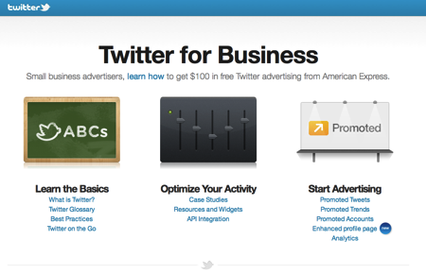

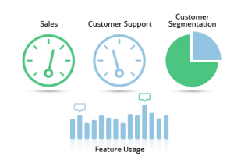

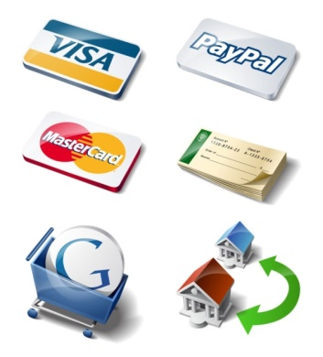






Who is generating Big Data?
Social
User Tracking & Engagement
Homeland Security
eCommerce
Financial Services
Real Time Search

Slide 5
Type of data
Relational Data (Tables/Transaction/Legacy Data)
Text Data (Web)
Semi-structured Data (XML)
Graph Data
Social Network, Semantic Web (RDF), …
Streaming Data
You can only scan the data once

Slide 6
What to do with these data?
Aggregation and Statistics
Data warehouse and OLAP
Indexing, Searching, and Querying
Keyword based search
Pattern matching (XML/RDF)
Knowledge discovery
Data Mining
Statistical Modeling

Slide 7
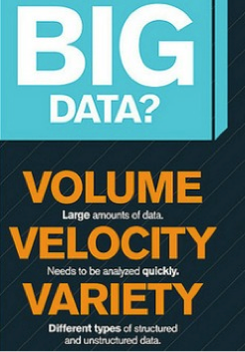

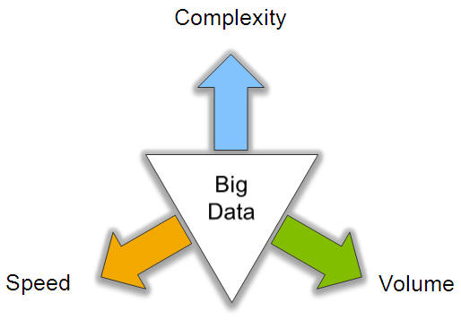
Big Data Characteristics: 3V

Slide 8
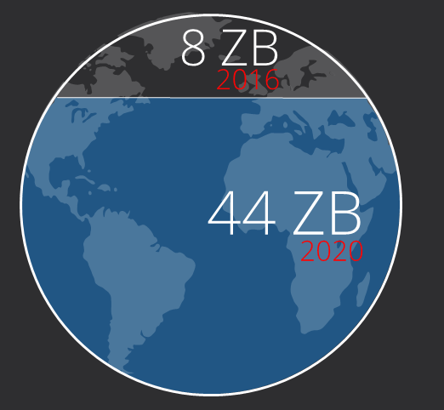

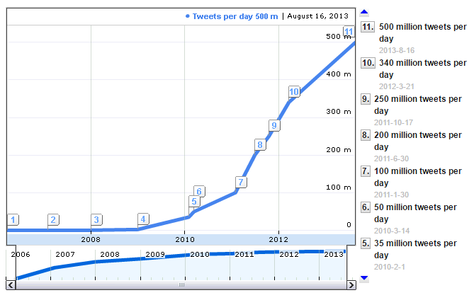
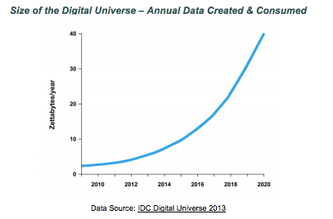
Volume (Scale)
Data Volume
Growth 40% per year
From 8 zettabytes (2016) to 44zb (2020)
Data volume is increasing exponentially
Exponential increase in collected/generated data

Slide 9
Variety (Complexity)
To extract knowledge➔ all these types of data need to linked together
Different Types:
Relational Data (Tables/Transaction/Legacy Data)
Text Data (Web)
Semi-structured Data (XML)
Graph Data
Social Network, Semantic Web (RDF), …
Streaming Data
You can only scan the data once
A single application can be generating/collecting many types of data
Different Sources：
Movie reviews from IMDB and Rotten Tomatoes
Product reviews from different provider websites

Slide 10
















Variety (contd.)
A Single View to the Customer
Social Media
Banking
Finance
Gaming
Our
Known
History
Customer
Entertain
Purchase

Slide 11







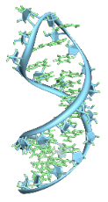
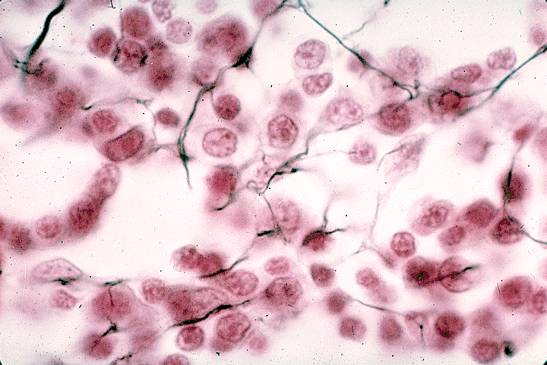






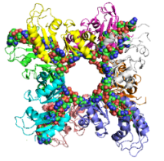
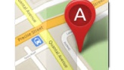
Variety (contd.)
A Global View of Linked Big Data
diagnosis
prescription
doctors
drug
patient
target
“Ebola”
mutation
tissue
gene
protein
Diversified social network
Heterogeneous information network

Slide 12
Velocity (Speed)
Data is begin generated fast and need to be processed fast
Online Data Analytics
Late decisions ➔ missing opportunities
Examples
E-Promotions: Based on your current location, your purchase history, what you like ➔ send promotions right now for store next to you
Healthcare monitoring: sensors monitoring your activities and body ➔ any abnormal measurements require immediate reaction
Disaster management and response

Slide 13
Real-Time Analytics/Decision Requirement
Product
Recommendations
that are Relevant
& Compelling
Learning why Customers
Switch to competitors
and their offers; in
time to Counter
Influence
Behavior
Friend Invitations
to join a
Game or Activity
that expands
business
Improving the
Marketing
Effectiveness of a
Promotion while it
is still in Play
Customer
Preventing Fraud
as it is Occurring
& preventing more
proactively

Slide 14
Extended Big Data Characteristics: 6V
Volume: In a big data environment, the amounts of data collected and processed are much larger than those stored in typical relational databases.
Variety: Big data consists of a rich variety of data types.
Velocity: Big data arrives to the organization at high speeds and from multiple sources simultaneously.
Veracity: Data quality issues are particularly challenging in a big data context.
Visibility/Visualization: After big data being processed, we need a way of presenting the data in a manner that’s readable and accessible.
Value: Ultimately, big data is meaningless if it does not provide value toward some meaningful goal.

Slide 15
Veracity (Quality & Trust)
Data = quantity + quality
When we talk about big data, we typically mean its quantity:
What capacity of a system provides to cope with the sheer size of the data?
Is a query feasible on big data within our available resources?
How can we make our queries tractable on big data?
. . .
Can we trust the answers to our queries?
Dirty data routinely lead to misleading financial reports, strategic business planning decision ⇒ loss of revenue, credibility and customers, disastrous consequences
The study of data quality is as important as data quantity

Slide 16
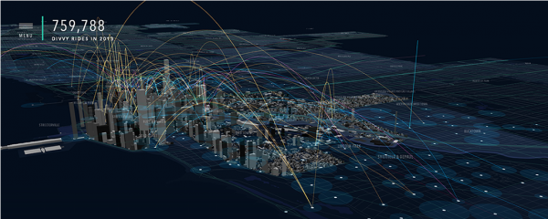
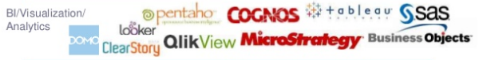
Visibility/Visualization
Visible to the process of big data management
Big Data – visibility = Black Hole?
Big data visualization tools:
A visualization of Divvy bike rides across Chicago

Slide 17
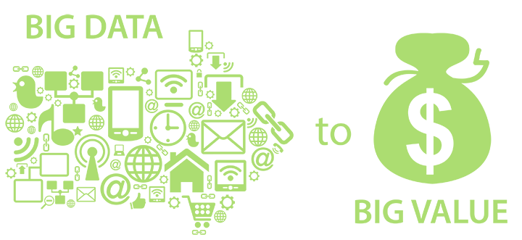
Value
Big data is meaningless if it does not provide value toward some meaningful goal

Slide 18
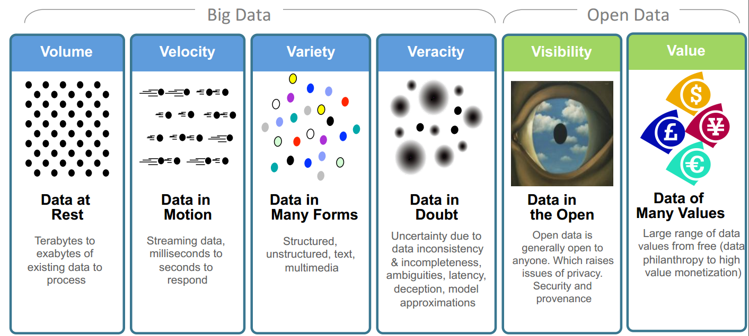
Big Data: 6V in Summary

Slide 19
Other V’s
Variability
Variability refers to data whose meaning is constantly changing. This is particularly the case when gathering data relies on language processing.
Viscosity
This term is sometimes used to describe the latency or lag time in the data relative to the event being described. We found that this is just as easily understood as an element of Velocity.
Virality
Defined by some users as the rate at which the data spreads; how often it is picked up and repeated by other users or events.
Volatility
Big data volatility refers to how long is data valid and how long should it be stored. You need to determine at what point is data no longer relevant to the current analysis.
More V’s in the future …

Slide 20
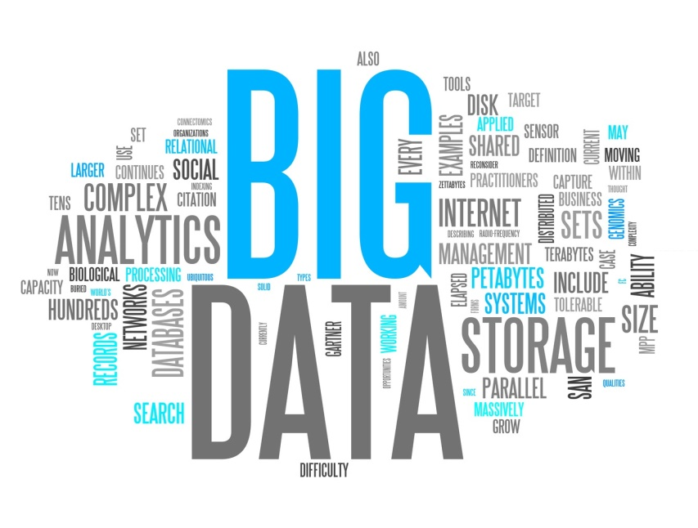
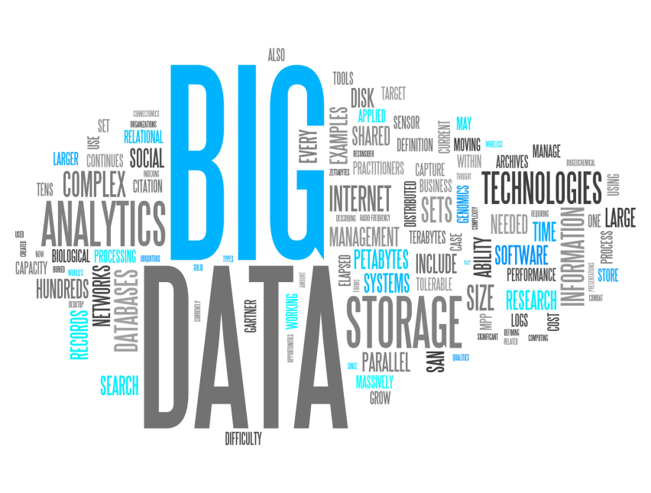
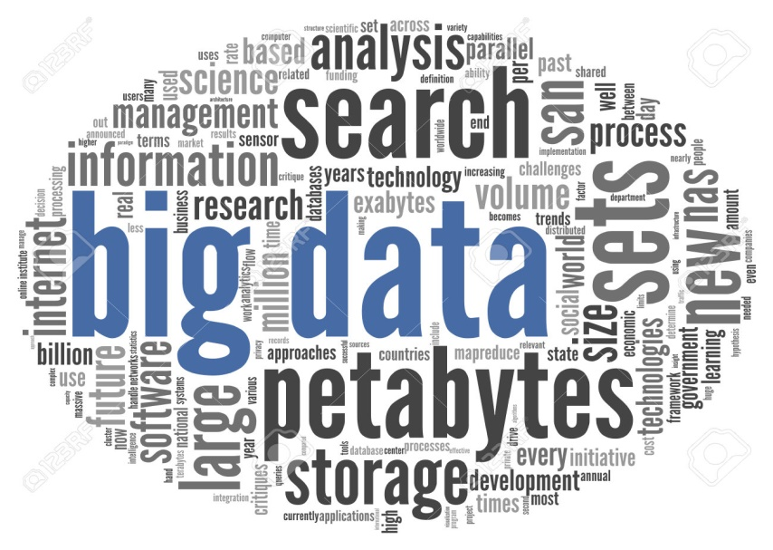
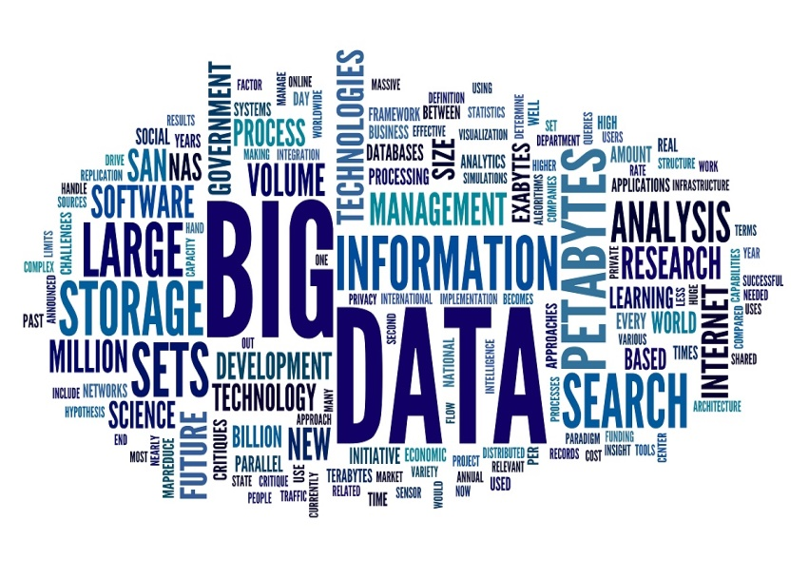

Slide 21
Advantages of Relational Databases
Well-defined database schema
Flexible query language
Maintain database consistency in business transactions:
Concurrent database processing with multiple users
Reading/updating
Locking

Slide 22
Transaction ACID Properties
Atomic
Transaction cannot be subdivided
All or nothing
Consistent
Constraints don’t change from before transaction to after transaction
A transaction transforms a database from one consistent state to another consistent state.
Isolated
Transactions execute independently of one another.
Database changes not revealed to users until after transaction has completed
Durable
Database changes are permanent and must not be lost.

Slide 23
Problems with relational databases in managing Big Data
High overhead in maintaining database consistency
Do not support unstructured data search very well (i.e. google type searching)
Do not handle data in unexpected formats well
Don’t scale well to very large size databases:
Expensive “scale up”: adding processer, storage
Slow query response time
Data must move to server
Server failure
Organizations such as Facebook, Yahoo, Google, and Amazon were among the first to decide that relational databases were not good solutions for the volumes and types of data that they were dealing with.

Slide 24
What is needed in new approach
Deal with data size never imagined before.
Hardware failure should be expected.
Data has gravity, compute has to move to data.

Slide 25
What is Hadoop?
Open source project by Apache Foundation
Based on papers published by Google
Google File System ( Oct, 2003)
MapReduce ( Dec, 2004)
Consists of two core components
Hadoop Distributed File System (Storage)
MapReduce (Compute)

Slide 26
How Hadoop fits in the new approach
Run on cluster of low cost commodity servers so can accommodate petabytes of data cost effectively.
Embraces partial failures
Data locality (computation on local node where
data resides)
Horizontally Scales
Scale Out
Hadoop file is:
Distributed: a file is stored in many servers
Replicated: a file is replicated with many copies

Slide 27
NoSQL Database
NotOnlySQL is a broad class of database management systems identified by non-adherence to the widely used relational database management system model.
They are useful when working with a huge quantity of data when the data's nature does not require a relational model.

Slide 28
Types of NoSQL Databases
Column-oriented database
Example: Cassandra
Document-oriented database:
Example: MongoDB, CouchDB
Data stored in JSON, JavaScript Object Notation, format

Slide 29
OLAP and data mining with Big Data
Warehouse Architecture
Client
Client
Query & Analysis
Metadata
Warehouse
Integration
Source
Source
Source

Slide 30
What is data mining?
Discovery of useful, possibly unexpected, patterns in data
Non-trivial extraction of implicit, previously unknown and potentially useful information from data
Exploration & analysis, by automatic or semi-automatic means, of large quantities of data in order to discover meaningful patterns

Slide 31
Data mining tasks
Classification
Clustering
Association Rule Discovery
Sequential Pattern Discovery
Regression
Deviation Detection
Collaborative Filter

Slide 32
Data mining tasks (cont.)
Classification:
Given a collection of records (training set )
Each record contains a set of attributes, one of the attributes is the class.
Find a model for class attribute as a function of the values of other attributes.
Goal: previously unseen records should be assigned a class as accurately as possible.
A test set is used to determine the accuracy of the model. Usually, the given data set is divided into training and test sets, with training set used to build the model and test set used to validate it.

Slide 33
Data mining tasks (cont.)
Decision Trees
Example:
Conducted survey to see what customers were interested in new model car
Want to select customers for advertising campaign
training
set

Slide 34



Data mining tasks (cont.)
Clustering
K-Means Clustering
income
education
age

Slide 35
Data mining tasks (cont.)
Association rule mining
transaction
id
customer
id
products
bought
sales
records:
market-basket
data
Trend: Products p5, p8 often bough together
Trend: Customer 12 likes product p9

Slide 36
Data mining tasks (cont.)
Association Rule Discovery
Marketing and Sales Promotion:
Let the rule discovered be
{Bagels, … } --> {Potato Chips}
Potato Chips as consequent => Can be used to determine what should be done to boost its sales.
Bagels in the antecedent => can be used to see which products would be affected if the store discontinues selling bagels.
Bagels in antecedent and Potato chips in consequent => Can be used to see what products should be sold with Bagels to promote sale of Potato chips!
Supermarket shelf management.
Inventory Management

Slide 37
Data mining tasks (cont.)
Collaborative Filtering
Goal: predict what movies/books/… a person may be interested in, on the basis of
Past preferences of the person
Other people with similar past preferences
The preferences of such people for a new movie/book/…
One approach based on repeated clustering
Cluster people on the basis of preferences for movies
Then cluster movies on the basis of being liked by the same clusters of people
Again cluster people based on their preferences for (the newly created clusters of) movies
Repeat above till equilibrium
Above problem is an instance of collaborative filtering, where users collaborate in the task of filtering information to find information of interest

Slide 38
Other types of mining
Text mining: application of data mining to textual documents
cluster Web pages to find related pages
cluster pages a user has visited to organize their visit history
classify Web pages automatically into a Web directory
Graph mining:
Deal with graph data

Slide 39
Data streams
What are Data Streams?
Continuous streams
Huge, Fast, and Changing
Why Data Streams?
The arriving speed of streams and the huge amount of data are beyond our capability to store them.
“Real-time” processing
Window Models
Landscape window (Entire Data Stream)
Sliding Window
Damped Window
Mining Data Stream

Slide 40


